Slide 1

Memory Management
Module 8

Slide 2
Topics
Why memory management is important
Linked lists
Linked lists vs ArrayLists
Heaps / Stacks
Garbage Collection

Slide 3
Why is memory management important?
Ensures that available memory resources are used effectively
Prevents memory leaks by releasing memory when no longer needed
Contributes to the overall performance of a system
Reduces the risk of security vulnerabilities

Slide 4
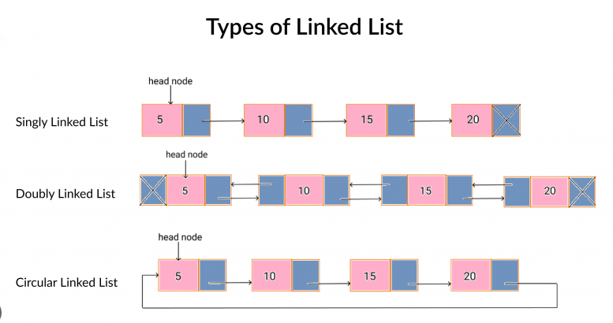
Linked lists
powerful data structures that offer:
dynamic memory allocation,
efficient insertion and deletion, and
flexibility in managing collections of data.
linked lists consist of nodes
each node contains two components:
the data itself and
a reference to the next node in the sequence
Types of linked lists:
Single linked lists
Double linked lists
Circular linked lists

Slide 5
Linked list vs arraylist
Linked List
ArrayList
dynamic memory allocation
can grow or shrink as needed without requiring contiguous memory blocks.
ability to efficiently insert or delete elements at any position within the list
No need for contiguous memory
Requires additional memory to hold address of next node
Lower memory overhead
No additional memory to hold address of next element
require shifting elements when inserting and/or deleting elements which lowers efficiency
Easy to code and understand

Slide 6
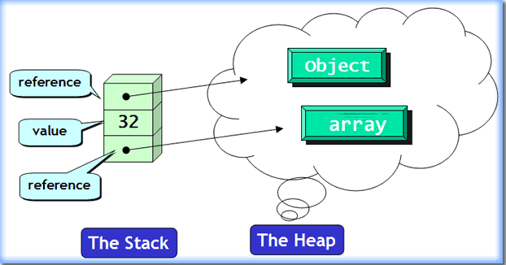
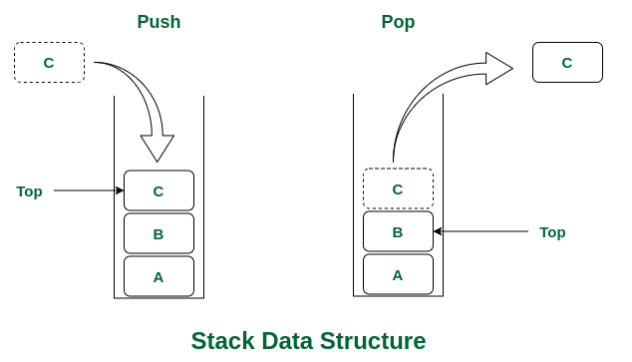
Heaps/stacks
Heaps
used to implement priority queues
heap sort algorithms
represent a dynamically allocated region of memory
region where the "new" operator allocates memory for objects. free pool/free store
Stacks
region where a method's local variables are allocated during a method call.
A method call “pushes” local variables to the stack, and a return “pops” from the stack

Slide 7
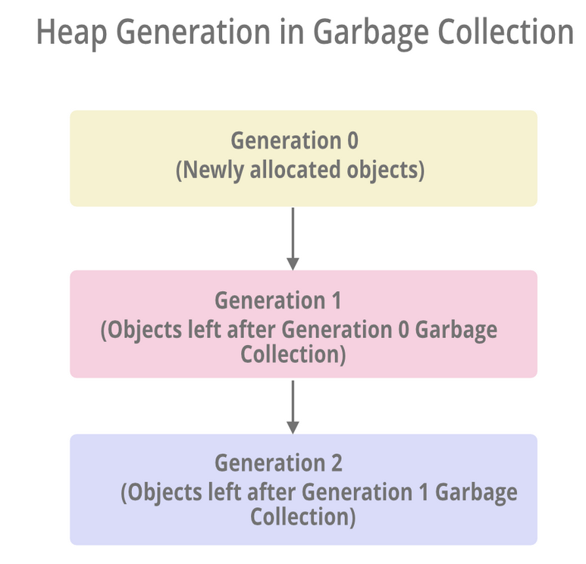
Garbage collection
Java Virtual Machine (JVM) handles memory management automatically
May involve stop-the-world events, where all application threads are paused temporarily while garbage collection takes place. During this pause, the JVM performs garbage collection activities, including marking and sweeping unreachable objects.
helps prevent memory leaks by reclaiming memory occupied by unreachable objects

Slide 8
End of lecture

